Slide 1
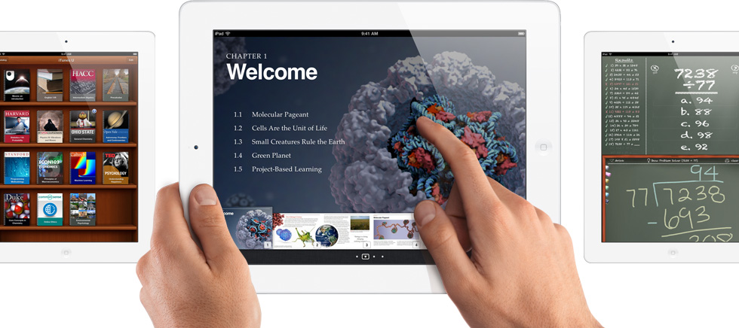
A
iSchool
Loredana Zima Krnelić, computer science teacher

Slide 2
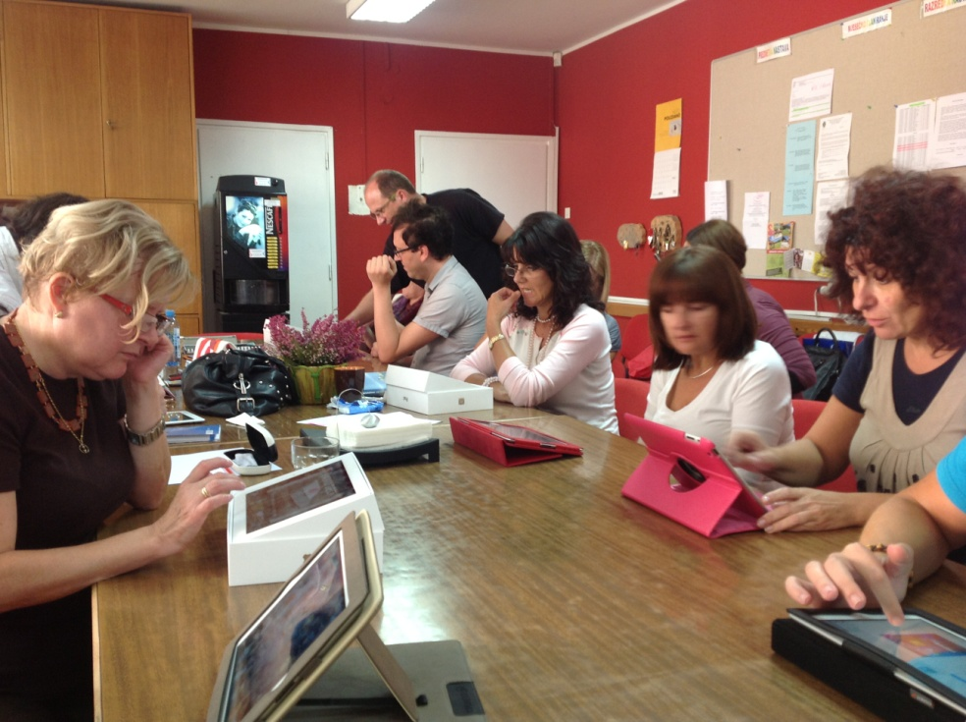
Project iSchool
Started this year in 8 ^{th} grade
57 tablets (iPad) - Apple
in cooperation with Faculty of Philosophy and in partnership with Apple

Slide 3
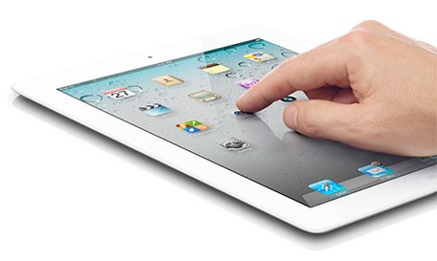
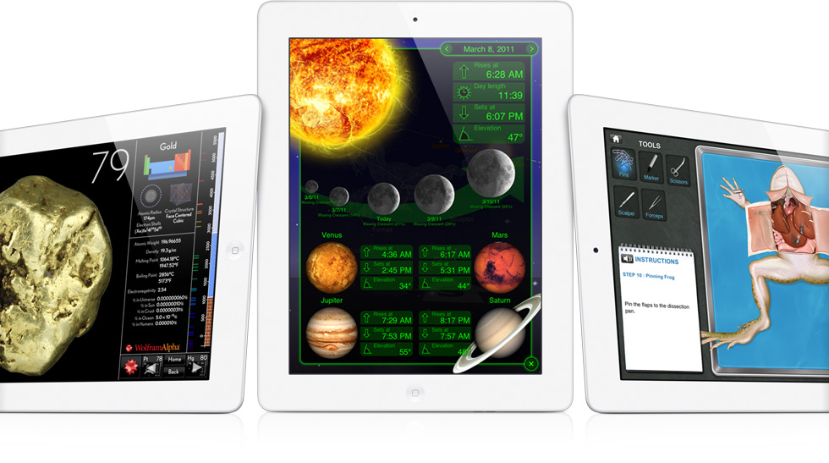
New learning environment
interactive learning with Internet access and lots of multimedia (wireless)
Video materials and digital books (iBookAuthor)
thousands of free educational applications for all subjects (learning trough playing)

Slide 4
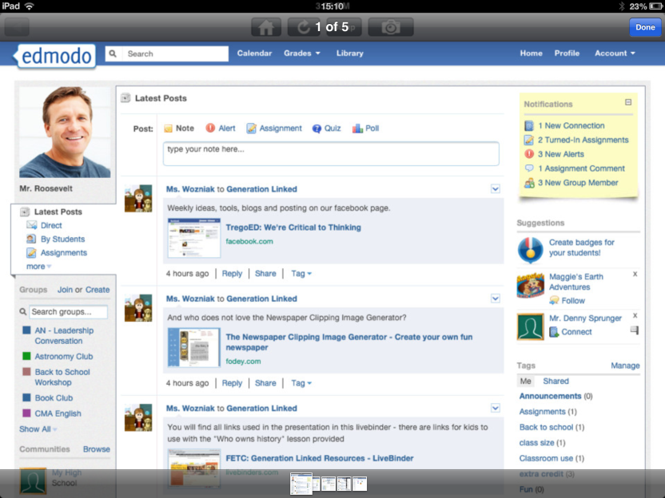
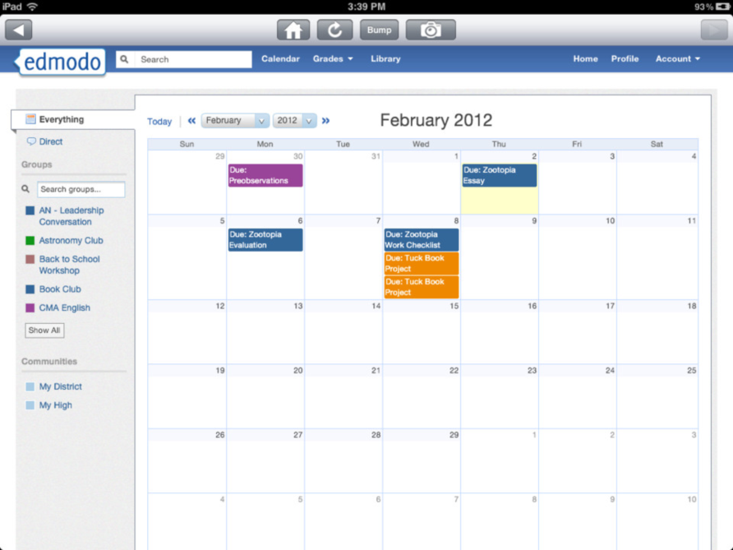
New learning environment
E-mail
Preparing for lessons
Online tests
E-books
E-learning
DIGITAL
SKILLS

Slide 5
New learning environment
Pupils will become active learners, exercising team work, problem solving, exploring and learning how to use knowledge instead of reproduce one
Move towards to creativity and collaboration, challenge based learning, collaborative and constructive learning, collaboration and partnership between pupils and teachers
Learning without frontiers
Notes:
For what i think many teachers will agree with me

Slide 6
Projects of MZOŠ
EduKnjižara
E-lektire
E-matica
E-dnevnik

Slide 7
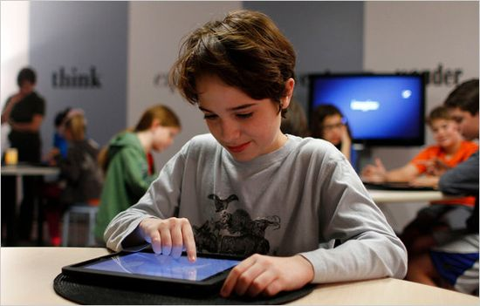
Project objectives
Hightened school success – increasing pupils engagement, pupils as active learners prepared for lifelong learning
Improved competency for living in modern digital age and the development of social awareness and responsibility towards new technologies
equalizing our pupils’ abilities with pupils from the developed countries

Slide 8
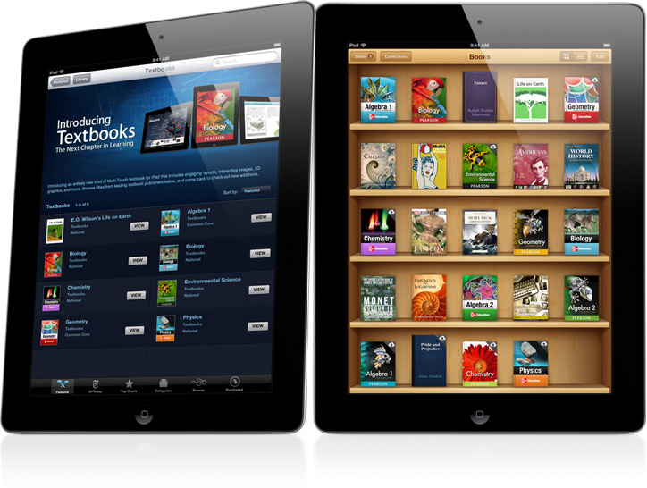
Project objectives
lighter school bags
(school bags weight is apx. 10 kg)
price of 1 iPad = price of books
digital learning materials
new modern curriculum

Slide 9
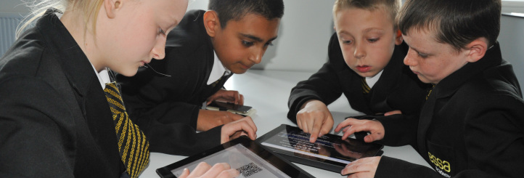
Apple Lighthouse School
Essa Academy (UK) - “All will succeed”
2007 started with iPads and had an unexpected result, surprising improvement of 97 % in pupils grades

Slide 10
Project evaluation
Internal evaluation:
teachers and pupils
project team
External evaluation:
Faculty of Philosophy Rijeka

